Slide 1
ADTs, Asymptotics II, BSTs
Exam-Level 06

Slide 2
Announcements
Sunday | Monday | Tuesday | Wednesday | Thursday | Friday | Saturday
 | 10/7 Weekly Survey 7 Due |  | 10/9 Homework 2 Due |  | 10/11 Lab 6 Due Midterm 2 Review Session
 |  | 10/15 Mid-Semester Survey Due |  |  | 10/18 Lab 7 Due Project 2A Due

Slide 3
Content Review

Slide 4
Asymptotics Advice
Asymptotic analysis is only valid on very large inputs, and comparisons between runtimes is only useful when comparing inputs of different orders of magnitude.
Use Θ where you can, but won’t always have tight bound (usually default to O)
Reminder: total work done = sum of all work per iteration or recursive call
While common themes are helpful, rules like “nested for loops are always N²” can easily lead you astray (pay close attention to stopping conditions and how variables update)
Drop lower-order terms (ie. n³ + 10000n² - 5000000 -> Θ(n³))

Slide 5
Asymptotics Advice
For recursive problems, it’s helpful to draw out the tree/structure of method calls
Things to consider in your drawing and calculations of total work:
Height of tree: how many levels will it take for you to reach the base case?
Branching factor: how many times does the function call itself in the body of the function?
Work per node: how much actual work is done per function call?
Life hack pattern matching when calculating total work where f(N) is some function of N
1 + 2 + 3 + 4 + 5 + … + f(N) = [f(N)]²
1 + 2 + 4 + 8 + 16 + … + f(N) = f(N)
Rule applies with any geometric factor between terms, like 1 + 3 + 9 + … + f(N)

Slide 6
Asymptotics Advice
Doing problems graphically can be helpful if you’re a visual learner (plot variable values and calculate area formula):
for (int i = 0; i < N; i++) {
for (int j = 0; j < i; j++) {
/* Something constant */
}
}
N
½ N² = N²
j
0
N
i

Slide 7
Binary Search Trees
Binary Search Trees are data structures that allow us to quickly access elements in sorted order. They have several important properties:
Each node in a BST is a root of a smaller BST
Every node to the left of a root has a value “lesser than” that of the root
Every node to the right of a root has a value “greater than” that of the root
BSTs can be bushy or spindly:
5
1
Bushy, O(logN)
3
7
2
1
4
6
9
Spindly, O(N)
3

Slide 8
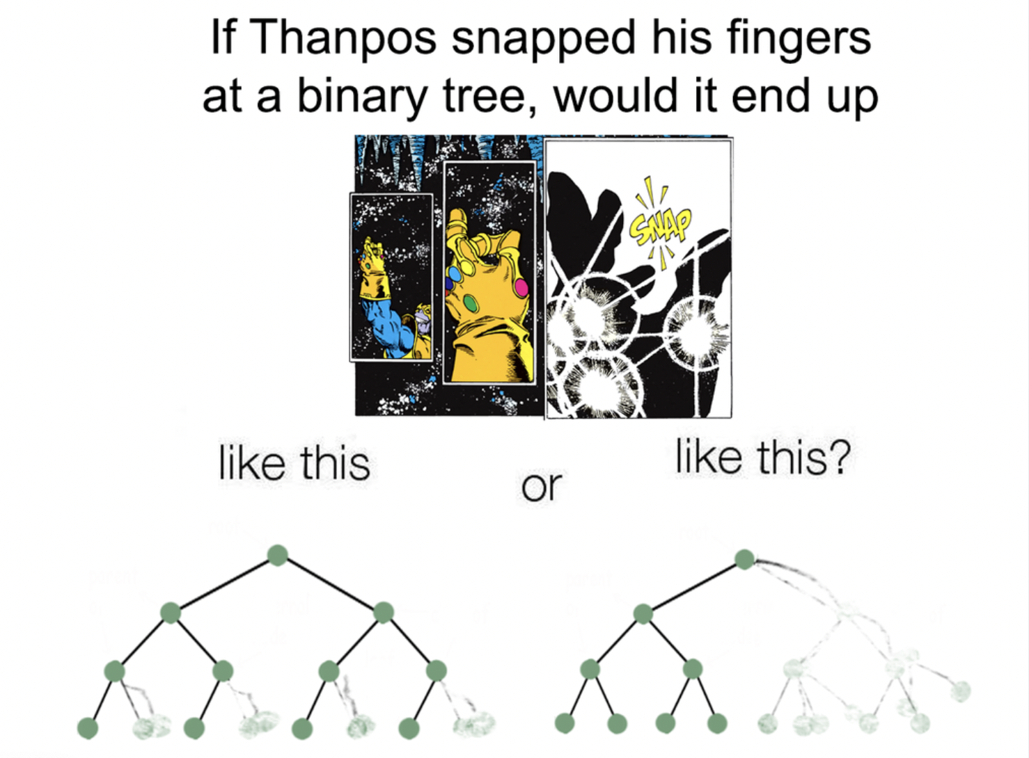

Slide 9
BST Insertion
Items in a BST are always inserted as leaves.
insert(2)
2
5
5
3
7
3
7
1
4
6
9
1
4
6
9
2

Slide 10
BST Deletion
Items in a BST are always deleted via a method called Hibbard Deletion. There are several cases to consider:
delete(2)
5
5
3
7
3
7
1
4
6
9
1
4
6
9
2
2
In this case, the node has no children so deletion is an easy process.

Slide 11
BST Deletion
Items in a BST are always deleted via a method called Hibbard Deletion. There are several cases to consider:
delete(1)
5
5
3
7
3
7
1
4
6
9
1
4
6
9
2
2
In this case, the node has one child, so it simply replaces the deleted node, and then we act as if the child was deleted in a recursive pattern until we hit a leaf.

Slide 12
BST Deletion
Items in a BST are always deleted via a method called Hibbard Deletion. There are several cases to consider:
delete(5)
5
5
3
7
3
7
1
4
6
9
1
4
6
9
2
2
In this case, the node has two children, so we pick either the leftmost node on in the right subtree or the rightmost node in the left subtree.

Slide 13
Worksheet

Slide 14
1 Finish the Runtimes
For each part, a desired runtime is given. Fill in the remaining blanks to achieve the desired runtime! There may be more than one correct answer.
Hint: You may find Math.pow helpful.
for (int i = 1; i < ______; i = ______) {
for (int j = 1; j < ______; j = ______) {
System.out.println("Circle is the best TA");
}
}

Slide 15
1 Finish the Runtimes
For each part, a desired runtime is given. Fill in the remaining blanks to achieve the desired runtime! There may be more than one correct answer.
Hint: You may find Math.pow helpful.
for (int i = 1; i < ______; i = ______) {
for (int j = 1; j < ______; j = ______) {
System.out.println("Circle is the best TA");
}
}

Slide 16
1 Finish the Runtimes
For each part, a desired runtime is given. Fill in the remaining blanks to achieve the desired runtime! There may be more than one correct answer.
Hint: You may find Math.pow helpful.
Desired runtime: Θ(N²)
for (int i = 1; i < N; i = i + 1) {
for (int j = 1; j < i; j = ______) {
System.out.println("This is one is low key hard");
}
}

Slide 17
1 Finish the Runtimes
For each part, a desired runtime is given. Fill in the remaining blanks to achieve the desired runtime! There may be more than one correct answer.
Hint: You may find Math.pow helpful.
Desired runtime: Θ(N²)
for (int i = 1; i < N; i = i + 1) {
for (int j = 1; j < i; j = j + 1) {
System.out.println("This is one is low key hard");
}
}
1 + 2 + 3 + … + N = Θ(N²)

Slide 18
1 Finish the Runtimes
For each part, a desired runtime is given. Fill in the remaining blanks to achieve the desired runtime! There may be more than one correct answer.
Hint: You may find Math.pow helpful.
Desired runtime: Θ(log N)
for (int i = 1; i < N; i = i * 2) {
for (int j = 1; j < ______; j = j * 2) {
System.out.println("This is one is mid key hard");
}
}

Slide 19
1 Finish the Runtimes
For each part, a desired runtime is given. Fill in the remaining blanks to achieve the desired runtime! There may be more than one correct answer.
Hint: You may find Math.pow helpful.
Desired runtime: Θ(log N)
for (int i = 1; i < N; i = i * 2) {
for (int j = 1; j < 2; j = j * 2) {
System.out.println("This is one is mid key hard");
}
}
i = 1, 2, 4, … N → log N iterations

Slide 20
1 Finish the Runtimes
For each part, a desired runtime is given. Fill in the remaining blanks to achieve the desired runtime! There may be more than one correct answer.
Hint: You may find Math.pow helpful. A possible solution is N / 2^N - can you think of another?
Desired runtime: Θ(2^{N})
for (int i = 1; i < N; i = i + 1) {
for (int j = 1; j < ______; j = j + 1) {
System.out.println("This is one is high key hard");
}
}

Slide 21
1 Finish the Runtimes
For each part, a desired runtime is given. Fill in the remaining blanks to achieve the desired runtime! There may be more than one correct answer.
Hint: You may find Math.pow helpful. A possible solution is N / 2^N - can you think of another?
Desired runtime: Θ(2^{N})
for (int i = 1; i < N; i = i + 1) {
for (int j = 1; j < Math.pow(2, i); j = j + 1) {
System.out.println("This is one is high key hard");
}
}
1 + 2 + 4 + … 2^{N} = Θ(2^{N})

Slide 22
1 Finish the Runtimes
For each part, a desired runtime is given. Fill in the remaining blanks to achieve the desired runtime! There may be more than one correct answer.
Hint: You may find Math.pow helpful.
Desired runtime: Θ(N³)
for (int i = 1; i < ______; i = i * 2) {
for (int j = 1; j < N * N; j = ______) {
System.out.println("yikes");
}
}

Slide 23
1 Finish the Runtimes
For each part, a desired runtime is given. Fill in the remaining blanks to achieve the desired runtime! There may be more than one correct answer.
Hint: You may find Math.pow helpful.
Desired runtime: Θ(N³)
for (int i = 1; i < Math.pow(2, N); i = i * 2) {
for (int j = 1; j < N * N; j = j + 1) {
System.out.println("yikes");
}
}
Outer loop: i = 1, 2, 4, …, 2^{N} → N iterations
Inner loop: N²

Slide 24
2A Asymptotics is Fun!
void g(int N, int x) {
if (N == 0) {
return;
}
for (int i = 1; i <= x; i++) {
g(N - 1, i);
}
}
g(N, 1): Θ( )
g(N, 2): Θ( )

Slide 25
2A Asymptotics is Fun!
void g(int N, int x) {
if (N == 0) {
return;
}
for (int i = 1; i <= x; i++) {
g(N - 1, i);
}
}
g(N, 1)
g(N - 1, 1)
…
g(1, 1)
g(N, 1): Θ( )
g(0, 1)

Slide 26
2A Asymptotics is Fun!
Work per node:
void g(int N, int x) {
if (N == 0) {
return;
}
for (int i = 1; i <= x; i++) {
g(N - 1, i);
}
}
g(N, 1)
1
g(N - 1, 1)
1
…
g(1, 1)
1
g(N, 1): Θ( )
g(0, 1)
1

Slide 27
2A Asymptotics is Fun!
Number of levels: N + 1
void g(int N, int x) {
if (N == 0) {
return;
}
for (int i = 1; i <= x; i++) {
g(N - 1, i);
}
}
g(N, 1)
1
g(N - 1, 1)
1
…
g(1, 1)
1
g(N, 1): Θ( )
g(0, 1)
1

Slide 28
2A Asymptotics is Fun!
void g(int N, int x) {
if (N == 0) {
return;
}
for (int i = 1; i <= x; i++) {
g(N - 1, i);
}
}
g(N, 1)
1
g(N - 1, 1)
1
…
g(1, 1)
1
g(N, 1): Θ(N)
(N + 1) * 1 = Θ(N)
g(0, 1)
1

Slide 29
2A Asymptotics is Fun!
void g(int N, int x) {
if (N == 0) {
return;
}
for (int i = 1; i <= x; i++) {
g(N - 1, i);
}
}
g(N, 2)
g(N - 1, 1)
g(N - 1, 2)
g(N - 2, 1)
g(N - 2, 2)
…
g(N, 2): Θ( )

Slide 30
2A Asymptotics is Fun!
void g(int N, int x) {
if (N == 0) {
return;
}
for (int i = 1; i <= x; i++) {
g(N - 1, i);
}
}
g(N, 2)
N - 1
g(N - 1, 1)
g(N - 1, 2)
g(N - 2, 1)
g(N - 2, 2)
N - 2
…
g(N, 2): Θ( )

Slide 31
2A Asymptotics is Fun!
void g(int N, int x) {
if (N == 0) {
return;
}
for (int i = 1; i <= x; i++) {
g(N - 1, i);
}
}
g(N, 2)
N - 1
g(N - 1, 1)
g(N - 1, 2)
g(N - 2, 1)
g(N - 2, 2)
N - 2
…
g(N, 2): Θ(N²)
(N - 1) + (N - 2) + … 1 = Θ(N²)

Slide 32
2B Asymptotics is Fun!
void g(int N, int x) {
if (N == 0) {
return;
}
for (int i = 1; i <= f(x); i++) {
g(N - 1, x);
}
}
g(N, 2): Ω( ), O( )

Slide 33
2B Asymptotics is Fun!
void g(int N, int x) {
if (N == 0) {
return;
}
for (int i = 1; i <= f(x); i++) {
g(N - 1, x);
}
}
g(N, 2): Ω(N), O( )
Best case: f(x) = 1 always → linear

Slide 34
2B Asymptotics is Fun!
void g(int N, int x) {
if (N == 0) {
return;
}
for (int i = 1; i <= f(x); i++) {
g(N - 1, x);
}
}
g(N, 2): Ω(N), O( )
Worst case: f(2) = 2 always

Slide 35
2B Asymptotics is Fun!
g(N, 2)
void g(int N, int x) {
if (N == 0) {
return;
}
for (int i = 1; i <= f(x); i++) {
g(N - 1, x);
}
}
g(N - 1, 2)
g(N - 1, 2)
g(N - 2, 2)
g(N - 2, 2)
g(N - 2, 2)
g(N - 2, 2)
…
…
…
g(0, 2)
g(0, 2)
g(0, 2)
g(0, 2)
g(N, 2): Ω(N), O( )
…

Slide 36
2B Asymptotics is Fun!
Work per node: constant
g(N, 2)
void g(int N, int x) {
if (N == 0) {
return;
}
for (int i = 1; i <= f(x); i++) {
g(N - 1, x);
}
}
g(N - 1, 2)
g(N - 1, 2)
g(N - 2, 2)
g(N - 2, 2)
g(N - 2, 2)
g(N - 2, 2)
…
…
…
g(0, 2)
g(0, 2)
g(0, 2)
g(0, 2)
g(N, 2): Ω(N), O( )
…

Slide 37
2B Asymptotics is Fun!
Number of levels: N
g(N, 2)
void g(int N, int x) {
if (N == 0) {
return;
}
for (int i = 1; i <= f(x); i++) {
g(N - 1, x);
}
}
g(N - 1, 2)
g(N - 1, 2)
g(N - 2, 2)
g(N - 2, 2)
g(N - 2, 2)
g(N - 2, 2)
…
…
…
g(0, 2)
g(0, 2)
g(0, 2)
g(0, 2)
g(N, 2): Ω(N), O( )
…

Slide 38
2B Asymptotics is Fun!
Number of levels: N
g(N, 2)
void g(int N, int x) {
if (N == 0) {
return;
}
for (int i = 1; i <= f(x); i++) {
g(N - 1, x);
}
}
g(N - 1, 2)
g(N - 1, 2)
g(N - 2, 2)
g(N - 2, 2)
g(N - 2, 2)
g(N - 2, 2)
…
…
…
1 + 2 + 4 + … 2^{N} = O(2^{N})
g(0, 2)
g(0, 2)
g(0, 2)
g(0, 2)
g(N, 2): Ω(N), O(2^{N})
…

Slide 39
2B Asymptotics is Fun!
void g(int N, int x) {
if (N == 0) {
return;
}
for (int i = 1; i <= f(x); i++) {
g(N - 1, x);
}
}
g(N, N): Ω(N), O( )
Best case: f(x) = 1 always → linear

Slide 40
2B Asymptotics is Fun!
void g(int N, int x) {
if (N == 0) {
return;
}
for (int i = 1; i <= f(x); i++) {
g(N - 1, x);
}
}
g(N, N): Ω(N), O( )
Worst case: f(N) = N always

Slide 41
2B Asymptotics is Fun!
g(N, N)
void g(int N, int x) {
if (N == 0) {
return;
}
for (int i = 1; i <= f(x); i++) {
g(N - 1, x);
}
}
g(N - 1, N)
g(N - 1, N)
g(N - 2, N)
g(N - 2, N)
g(N - 2, N)
g(N - 2, N)
…
…
…
g(0, N)
g(0, N)
g(0, N)
g(0, N)
g(N, N): Ω(N), O( )
…

Slide 42
2B Asymptotics is Fun!
Work per node: N
g(N, N)
void g(int N, int x) {
if (N == 0) {
return;
}
for (int i = 1; i <= f(x); i++) {
g(N - 1, x);
}
}
g(N - 1, N)
g(N - 1, N)
g(N - 2, N)
g(N - 2, N)
g(N - 2, N)
g(N - 2, N)
…
…
…
g(0, N)
g(0, N)
g(0, N)
g(0, N)
g(N, N): Ω(N), O( )
…

Slide 43
2B Asymptotics is Fun!
Number of levels: N
g(N, N)
void g(int N, int x) {
if (N == 0) {
return;
}
for (int i = 1; i <= f(x); i++) {
g(N - 1, x);
}
}
g(N - 1, N)
g(N - 1, N)
g(N - 2, N)
g(N - 2, N)
g(N - 2, N)
g(N - 2, N)
…
…
…
1 + 2 + 4 + … N^{N} = O(N^{N})
g(0, N)
g(0, N)
g(0, N)
g(0, N)
…
g(N, N): Ω(N), O(N^{N})

Slide 44
3A Is This a BST?
The following code should check if a given binary tree is a BST. However, for some trees, it returns the wrong answer. Give an example of a binary tree for which brokenIsBST fails.
public static boolean brokenIsBST(BST tree) {
if (tree == null) {
return true;
} else if (tree.left != null && tree.left.key > tree.key) {
return false;
else if (tree.right != null && tree.right.key < tree.key) {
return false;
} else {
return brokenIsBST(tree.left) && brokenIsBST(tree.right);
}
}

Slide 45
3A Is This a BST?
The following code should check if a given binary tree is a BST. However, for some trees, it returns the wrong answer. Give an example of a binary tree for which brokenIsBST fails.
public static boolean brokenIsBST(BST tree) {
if (tree == null) {
return true;
} else if (tree.left != null && tree.left.key > tree.key) {
return false;
else if (tree.right != null && tree.right.key < tree.key) {
return false;
} else {
return brokenIsBST(tree.left) && brokenIsBST(tree.right);
}
}
10
5
15
3
12

Slide 46
3B Is This a BST?
Now, write isBST that fixes the error encountered in part (a).
public static boolean isBST(BST T) {
}
public static boolean isBSTHelper(BST T, int min, int max) {
}

Slide 47
3B Is This a BST?
public static boolean isBST(BST T) {
return isBSTHelper(T, Integer.MIN_VALUE, Integer.MAX_VALUE);
}
public static boolean isBSTHelper(BST T, int min, int max) {
}

Slide 48
3B Is This a BST?
public static boolean isBST(BST T) {
return isBSTHelper(T, Integer.MIN_VALUE, Integer.MAX_VALUE);
}
public static boolean isBSTHelper(BST T, int min, int max) {
if (T == null) {
return true;
}
}

Slide 49
3B Is This a BST?
public static boolean isBST(BST T) {
return isBSTHelper(T, Integer.MIN_VALUE, Integer.MAX_VALUE);
}
public static boolean isBSTHelper(BST T, int min, int max) {
if (T == null) {
return true;
} else if (T.key <= min || T.key >= max) {
return false;
}
}

Slide 50
3B Is This a BST?
public static boolean isBST(BST T) {
return isBSTHelper(T, Integer.MIN_VALUE, Integer.MAX_VALUE);
}
public static boolean isBSTHelper(BST T, int min, int max) {
if (T == null) {
return true;
} else if (T.key <= min || T.key >= max) {
return false;
} else {
return isBSTHelper(T.left, min, T.key)
&& isBSTHelper(T.right, T.key, max);
}
}

Slide 51

Attendance
tinyurl.com/61b-disc-fa24-new

